Slide 1
Language Theory
Adeesha Wijayasiri

Slide 2
Language Theory
We’ll Define
Alphabet
String
Catenation
Reflexive, Transitive Closure
Language
Language Constructor

Slide 3
Language Theory
Definition: An alphabet (or vocabulary) Σ is a finite set of symbols.

Slide 4
Language Theory
Definition: A sequence t = t₁t₂…t_{n} of symbols from an alphabet Σ is a string.
Definition: The length of a string t = t₁t₂…t_{n} (denoted |t|) is n. If n = 0, the string is ε, the empty string.
Definition: Given strings s = s₁s₂…s_{n} and
t = t₁t₂…t_{m}, the concatenation of s and t, denoted st, is the string s₁s₂…s_{n}t₁t₂…t_{m}.
Note: εu = u = uε, uεv = uv, for any strings u,v (including ε)

Slide 5
Language Theory
Definition: Σ* is the set of all strings of symbols from Σ.
Σ* is called the reflexive, transitive closure of Σ.
Σ* is described by a graph: (Σ*, ·), where “·” denotes concatenation, and there is a designated “start” node, namely ε.

Slide 6
Language Theory
Example: Σ = {a, b}.
(Σ*, ·)
a
aa
a
aba
a
a
b
ab
b
ε
abb
b
a
ba
b
b
bb

Slide 7
Language Theory
Example: Σ = C vocabulary. Then,
Σ* = all possible alleged C programs, i.e.
all possible inputs to the C compiler.
Need to specify L ⊂ Σ*, the correct C programs.
Definition: A language L over an alphabet Σ
is a subset of Σ*.

Slide 8
Language Theory
Example: Σ = {a, b}.
L1 = ø is a language
L2 = {ε} is a language
L3 = {a} is a language
L4 = {a, ba, bbab} is a language
L5 = {a^{n}b^{n} / n >= 0},
where a^{n} = aa…a, n times, is a language
L6 = {a, aa, aaa, …} is a language
Note: L5 is an infinite language, but described finitely.

Slide 9
Language Theory
THE MAIN GOALS OF LANGUAGE SPECIFICATION :
Describe (infinite) programming languages finitely
Provide corresponding finite inclusion-test algorithms.
Will accomplish with grammars (soon)

Slide 10
Language Theory
Definition: The catenation (or product) of two languages L₁ and L₂, denoted L₁L₂, is the set
{uv | u∈L₁, v∈L₂}.
Example: L₁ = {ε, a, bb}, L₂ = {ac, c}
L₁L₂ = {ac, c, aac, ac, bbac, bbc}
= {ac, c, aac, bbac, bbc}

Slide 11
Language Theory
Definition: L^{n} = LL … L (n times), and L⁰ = {ε}.
Example: L = {a, bb}
L³ =
{aaa, aabb, abba, abbbb, bbaa,
bbabb, bbbba, bbbbbb}

Slide 12
Language Theory
Definition: The union of two languages L₁ and L₂ is the set L₁U L₂ = {u | u∈L₁} U { v | v∈L₂}
Definition: The Kleene star (L*) (reflexive, transitive closure) of a language is the set L* = UL^{n}, n >0.
Example: L = {a, bb}
L* = {any string composed of a’s and bb’s}

Slide 13
Language Theory
Definition: The Transitive Closure (L⁺) of a language L is the set L⁺ = U L^{n}, n > 1.
Warning:
In general, L* = L⁺ U {ε}, but L⁺ ≠ L* - {ε}.
For example, consider L = {ε}. Then
{ε} = L⁺ ≠ L* – {ε} = {ε} – {ε} = ø.

Slide 14
Language Theory
We’ve Defined:
Alphabet, String, Catenation
Reflexive, Transitive Closure
Language, Language Constructors
Catenation, Union, Kleene Star
Next: Grammars

Slide 15
grammars
We’ll Cover
Grammars
Derivations

Slide 16
grammars
Goal:
Provide a means for describing (infinite) languages finitely.
How: Define a subgraph (Σ*, →*) of (Σ*, ·).
Define a start node S.
Nodes reachable from S are in the language.

Slide 17
grammars
Example: Σ = {a, b}
L = {a^{n}b^{n} / n > 0}
a
aaa
a
aa
a
aaba
a
b
b
aab
b
a
ab
aabb
ε
a
a
ba
bbaa
b
b
a
bba
b
bb
b
bbab
b
bbb

Slide 18
grammars
Definition: Given a vocabulary V, a production is a pair
(u, v) ∈ V* x V*, denoted u → v.
u is called the left-part; v is called the right-part.
Definition: Given a finite set of productions P ⊆ V* x V* the relation => (derives) is defined such that
α, β, u, v ∈ V* , αuβ => αvβ iff
u → v ∈ P is a production.

Slide 19
Grammars (example)
Productions:
Sentence → NP VP
NP → N
NP → Adj NP
N → boy
N → girl
Adj → the
Adj → tall
Adj → jealous
VP → V NP
V → hit
V → bit
Derivation:
Sentence
=> NP VP
=> Adj NP VP
=> the NP VP
=> the Adj NP VP
=> the jealous NP VP
=> the jealous N VP
=> the jealous girl VP
=> the jealous girl V NP
=> the jealous girl hit NP
=> the jealous girl hit Adj NP
=> the jealous girl hit the NP
=> the jealous girl hit the N
=> the jealous girl hit the boy
Note: English is much too complicated for this.

Slide 20
grammars
Definition: A grammar is a 4-tuple G = (Φ, Σ, P, S), where
Φ is a finite set of nonterminals,
Σ is a finite set of terminals,
V = Φ U Σ is the grammar’s vocabulary,
S ∈ Φ is called the start or goal symbol,
and P ⊂ V* x V* is a finite set of productions.
Example: Grammar for {a^{n}b^{n} / n > 0}:
G = (Φ, Σ, P, S), with Informally,
Φ = {S},
Σ = {a, b}, S → aSb
and P = { (S,aSb), (S,ε) } S →

Slide 21
grammars
Grammar: S → aSb Language: {a^{n}b^{n} / n > 0}
S →
Derivations:
S => aSb => aaSbb => aaaSbbb => aaaaSbbbb =>…
ε ab aabb aaabbb aaaabbbb
Normally, grammars are given by simply listing the productions.
=>
=>
=>
=>
=>

Slide 22
Grammars - Summary
Defined:
Grammar (4-tuple)
Informal grammar
List of productions
Derivation

Slide 23
Language and Grammar classes
We’ll Cover
Grammar Conventions
Sample Grammars
The Chomsky Hierarchy
Regular Languages
Context-free Languages
Context-sensitive Languages
Recursively Enumerable Languages

Slide 24
Grammar conventions
Upper case letter – nonterminal
Lower case letter – terminal
Lower case greek letter – strings in V*
Left part of the first production: start symbol.
If same as previous, omit left part.
Example:
S → aSb
→ ε

Slide 25
Language and Grammar classes
Definition: The language generated by a grammar G, is the set L(G) = {α ∈ Σ* | S =>* α }
Definition: A sentential form generated by a grammar G is any string α such that S =>* α .
Definition: A sentence generated by a grammar G is any sentential form α such that α ∈ Σ*.
Lemma: L(G) = {α | is a sentence}
Proof: Trivial.

Slide 26
A regular grammar
Example: Grammar for identifiers.
Identifier → Letter
→ Identifier Letter
→ Identifier Digit
Letter → ‘a’ → ‘A’
→ ‘b’ → ‘B’
. . .
→ ‘z’ → ‘Z’
Digit → ‘0’
→ ‘1’
. . .
→ ‘9’

Slide 27
A context-free grammar
Grammar: S → aSb Language pattern:
S → {a^{n}b^{n} / n > 0}
sentential forms
S => aSb => aaSbb => aaaSbbb => aaaaSbbbb =>…
ε ab aabb aaabbb aaaabbbb
sentences
=>
=>
=>
=>
=>

Slide 28
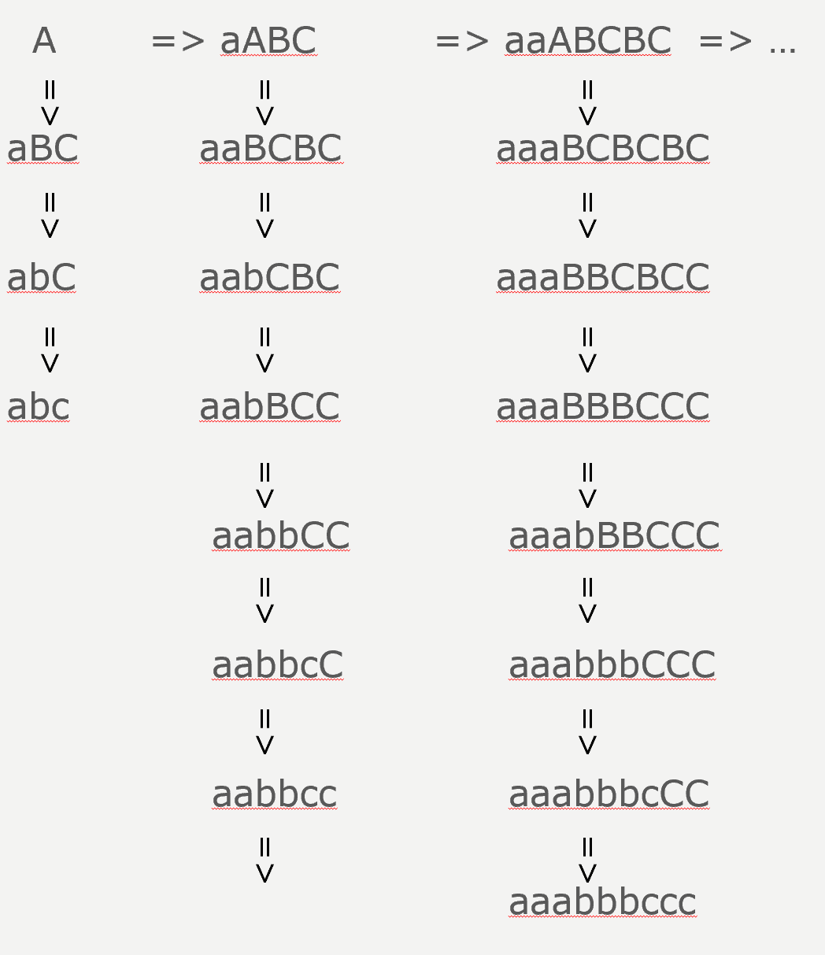
A context-sensitive Grammar
A → aABC
→ aBC
aB → ab
bB → bb
bC → bc
CB → BC
cC → cc
Language pattern:
{a^{n}b^{n}c^{n} | n > 1}

Slide 29
The chomsky hierachy
A hierarchy of grammars, the languages they generate, and the machines that accept those languages.
Developed by Noam Chomsky (MIT) in 1957.
Linguist, philosopher, cognitive scientist, historian, logician.
Four language levels:
Regular languages: {a^{n} | n > 1}
Context-free languages: {a^{n} b^{n} / n > 0}
Context-sensitive languages: {a^{n} b^{n} c^{n} | n > 1}
Unrestricted: (no pattern)

Slide 30
The chomsky hierachy
Type | Language Name | Grammar Name | Restrictions On grammar | Accepting Machine
0 | Recursively Enumerable | Unrestricted re-writing system | None | Turing Machine
1 | Context-Sensitive Language | Context- Sensitive Grammar | For all α→β, |α|≤|β| | Linear Bounded Automaton
2 | Context- Free Language | Context- Free Grammar | For all α→β, α∈Φ. | Push-Down Automaton (parser)
3 | Regular Language | Regular Grammar | For all α→β, α∈Φ, β∈Σ U ΣΦ U {ε} | Finite- State Automaton

Slide 31
The chomsky hierachy
0: Recursively Enumerable Languages
1: Context-Sensitive Languages
Type 3: appropriate for lexical analysis (scanning).
Type 2: appropriate for Syntax analysis (parsing)
2: Context-free Languages
3: Regular Languages
{a^{n} | n > 0}
{a^{n}b^{n} | n>0}
{a^{n}b^{n}c^{n} | n>0}

Slide 32
summary
Grammar Conventions
The Chomsky Hierarchy
Regular Languages (good for scanning)
Context-free Languages (good for parsing)
Context-sensitive Languages
Recursively Enumerable Languages

Slide 33
Topics
Regular Grammars
Grammar to State Diagram (FSA)

Slide 34
Regular grammars
Definition: A grammar G = (Φ, Σ, P, S) is regular iff
either (but not both):
Every production is of the form
A → α
or A → αB (right linear)
Every production is of the form
A → α
or A → Bα (left linear),
where α ∈ Σ*, and A, B ∈ Φ.

Slide 35
Regular grammars
Examples:
G1: S → a R → abaU
→ bU → U Regular? Why?
→ bR U → b
→ aS
G2: S → a R → Uaba
→ Ub U → b Regular? Why?
→ Rb → aS

Slide 36
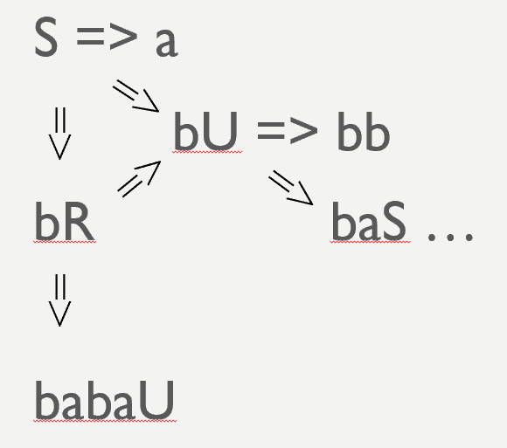
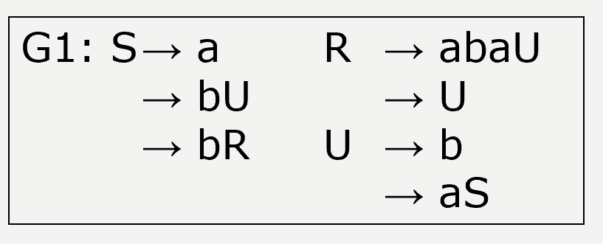
Regular grammars
Let’s devise a machine that accepts L(G1).
All sentential forms (except sentences) have ONE nonterminal.
The nonterminal occurs in the right-most position.
Applicable productions depend only on that nonterminal.

Slide 37
Regular grammars
Encode possible derivation sequences with a relation
⊢ (moves-to) on pairs of the form (q, α), where
q – current state
α – remaining string to accept
So, S → bU implies (S, bβ) ⊢ (U, β)
State “sentential
form ends in S”
“moves
to”
state “sentential form ends in U”

Slide 38
Regular grammars
Define a graph,
one node per nonterminal,
actions on each sentential form.
S → bU implies ,
R → U implies , and
S → a implies .
b
S
U
ε
R
U
a
S
F

Slide 39
Regular grammar to transition diagram
S
b
a
Advantage of diagram:
Easier to visualize
b
R
F
a
ε
aba
b
U

Slide 40
Regular grammar to transition diagram
In general, conversion from right-linear grammar G=(Φ, Σ, P, S) to transition diagram:
Nodes: Φ ∪ {F}, F ∉ Φ
if A → α B
if A → α
α
A
B
A
α
F
S

Slide 41
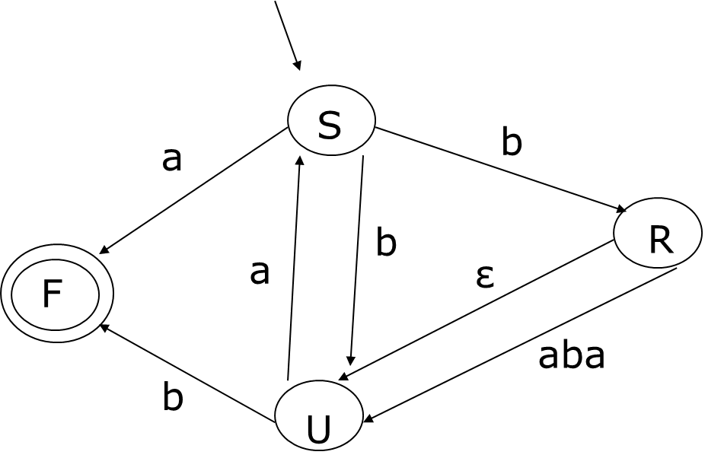
Advantage of Transition diagram: good for parsing
Example: Is “babaa” in L(G)?
Node Input Derivation
S babaa S =>
U abaa bU =>
S baa baS =>
U aa babU =>
S a babaS =>
F babaa
Note: Use of graph is non-deterministic. Will fix later.

Slide 42
summary
Defined regular grammar
Conversion from Right-Linear Grammar to Transition Diagram (Graph)
Advantages of Graph:
Easier to Visualize
Can actually parse (non-deterministically)

Slide 43
Acknowledgements
Programming Language Pragmatics by Michael L. Scott. 3rd edition. Morgan Kaufmann Publishers. (April 2009).
Lecture Slides of Dr.Malaka Walpola and Dr.Bermudez

